Slide 1

Achieving Microsecond Scale Tail Latency Efficiently With Approximate Optimal Scheduling Masoud Heidary

Slide 2
What is scheduling ?
Sharing a single resource (e.g. CPU core) by multiple tasks
T0
T1
T2
T0
T3
T0
Time
Problem? Task change frequency ↑ Efficiency ↓
Solution?

Slide 3
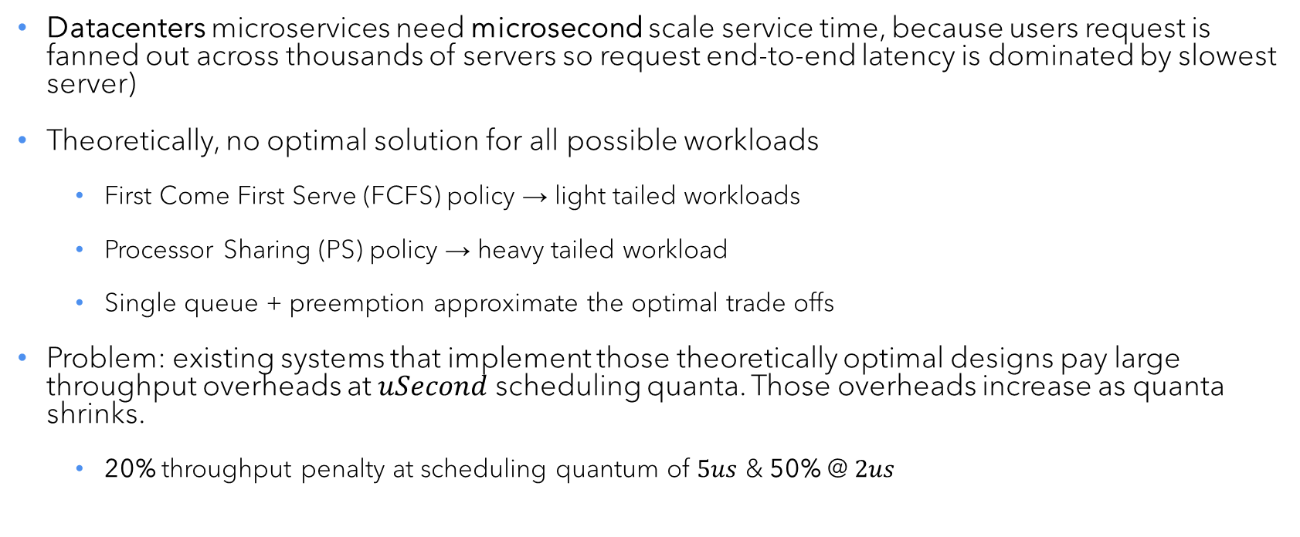
Introduction
Datacenters microservices need microsecond scale service time, because users request is fanned out across thousands of servers so request end-to-end latency is dominated by slowest server)
Theoretically, no optimal solution for all possible workloads
First Come First Serve (FCFS) policy → light tailed workloads
Processor Sharing (PS) policy → heavy tailed workload
Single queue + preemption approximate the optimal trade offs
Problem: existing systems that implement those theoretically optimal designs pay large throughput overheads at $uSecond$ scheduling quanta. Those overheads increase as quanta shrinks.
20% throughput penalty at scheduling quantum of $5us$ & 50% @ $2us$
Task change penalty
T0
T1
T2
T0
T3
T0
Time

Slide 4
Model
Cloud based server
Worker
(CPU)
Dispatcher
Worker
Task
Task
Task
Task
Task
Worker
T0
T1
T2
T0
T3
T0
Time

Slide 5

Modeling of overhead
Overhead is fraction of CPU cycles that do not contribute towards application goodput
$$overhead_{(per worker)}=\frac{c_{proc}+c_{pre}+c_{fin}}{S}$$
Lost cycles during processing beyond application logic
Include: underlying runtime, logging, …
Lost cycles in each preemption
including switch cost and inter thread communications
Lost cycles due to communication of worker with dispatcher after finishing request
(Service time)

Slide 6
Source of overhead – Preemptive Scheduling $\left(C_{proc}\right)$
Two methods to implement preemptive at microseconds, interrupts & code instrumentation
Interrupt based: dispatcher sends an inter-processing interrupt (IPI) to a worker to change running task
Pros: worker promptly stops process, Cons: large cost of receiving IPI (1200 cycles)
Overhead at microsecond is high (12% @ 5us, 30% @ 2us)
IPI to take the CPU control from T0 task
T0
T3
Time

Slide 7
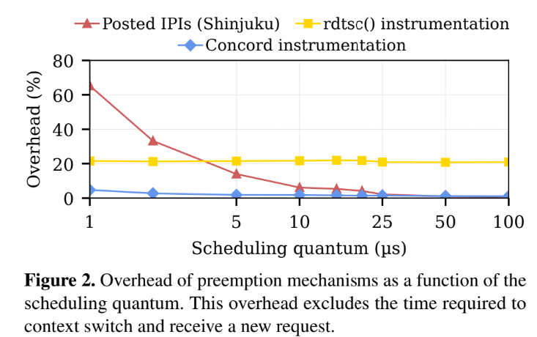
Source of overhead – Preemptive Scheduling $\left(C_{proc}\right)$
Instrumentation based: compiler inserts bookkeeping probes at regular intervals in the application code, and yield when executing is elapsed.
Probe cost (rdtsc()) is 30 cycles, inserting them frequently will result in high overhead, while infrequent insertion leads to poor preemption
Overhead at fixed fraction of service time and independent overhead from scheduling quantum
rdtsc()
T0
T3
Time

Slide 8
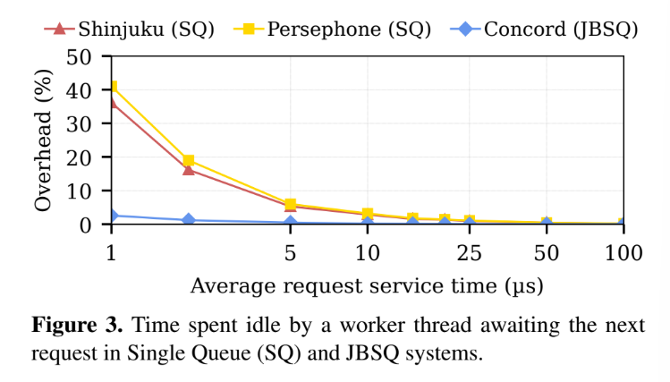
Source of overhead, sync inter thread communications $\left(C_{pre}\right)$
Each thread worker first finish processing the current request, then pull the next request from the dispatcher.
To avoid concurrency issues when multiple workers pulling from the dispatcher, implement a single queue as follows:
Workers set a flag when finishing a request, then poll a dedicated cache line for a new request
The dispatcher continuously polls the workers flags and send a new request as soon as a flag is set
This will result into wasted CPU cycles since workers are idle until dispatcher sends them a new request (+400 cycles)
T1
T2
Time

Slide 9
Source of overhead, Dedicated Dispatcher $\left(C_{fin}\right)$
Dedicated dispatcher does not run application logic even when idle. Dedicating 1 core in a large server does not impact throughput, but has a serious impact for Virtual Machines (VMs).
For example:
16 cores = 1 dispatcher + 15 worker threads
serving same workload from a 4-vCPU VM in the cloud, dispatcher only serves 3 workers
result: dispatcher is idle 80% of the time
dispatcher
worker
T0
T1
T2
T0
T3
T0
Time

Slide 10
3-step solution
Concord’s design is driven by approximation of optimal scheduling policies, enabling efficient, low overhead mechanism
Compiler enforced cooperative preemption: approximate precise preemption with low overhead using compiler instruction and async thread communications between worker thread and dispatcher. While this async leads to slightly imprecise scheduling, it does not significantly impact tail latency.
Join Bounded Shortest Queue (JBSQ): approximate a single queue via bounded core local queue and a dispatcher, reducing cache stalls.
Work conserving dispatcher: dispatcher both enqueues, when workers are busy, can run application logic itself (rather than being idle to contribute to throughput)

Slide 11
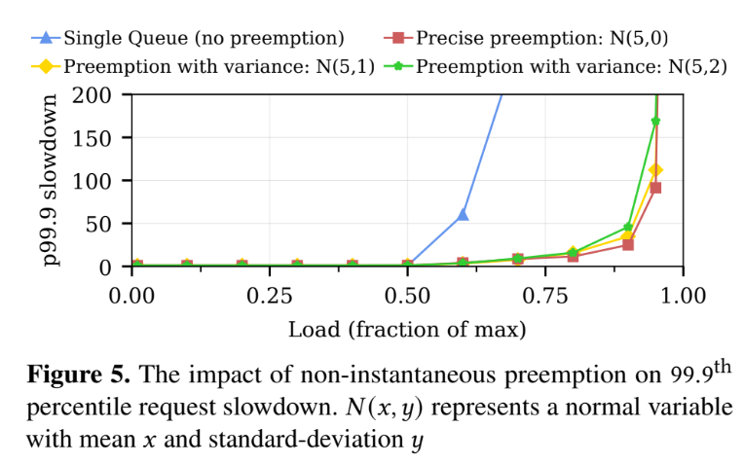
3-step solution, compiler enforced cooperation
Replaced expensive interrupts with a compiler enforced mechanism
Worker and dispatcher communicate over a dedicated shared cache line instead of IPI (150 CPU cycles per cache miss vs 1200 cycles IPI) -> 8x cheaper
Workers only preempt when they read a polling point, not instantly
T0
T3
T0
T3
Time

Slide 12
3-step solution, stall free workers
Eliminate throughput caused by idle worker threads waiting for new requests.
Traditional centralized single-queue systems: workers pull new reuquest after finishing one
Concord’s solution JBSQ: each worker has a small local queue, dispatcher pushes new requests from central queue to shortest available per-worker queue.
T0
T1
T2
T0
T1
T2
Time

Slide 13
3-step solution, work conserving dispatcher
When all workers are busy, dispatcher temporarily acts as an extra worker.
Keeps CPU utilization 100% work conserving.
dispatcher
dispatcher
Time

Slide 14
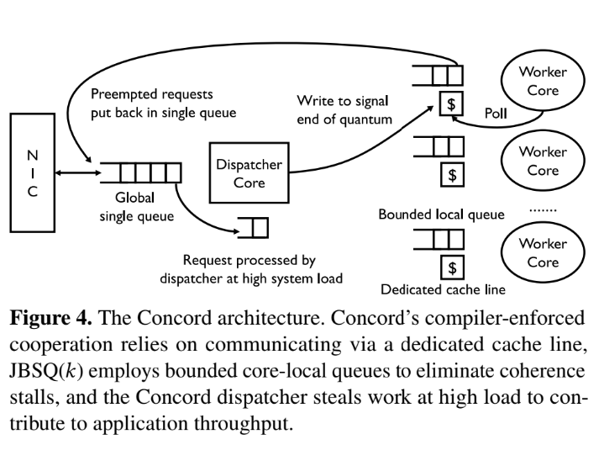

Slide 19
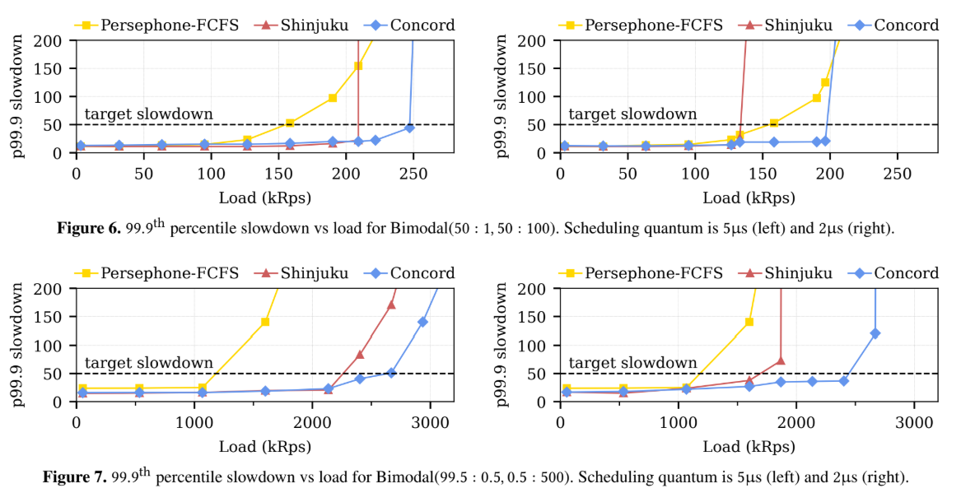
result

Slide 20
Thank you
Masoud Heidary
mheidary@cougarnet.uh.edu

